Slide 1
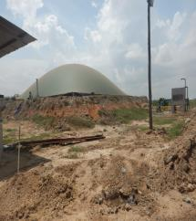
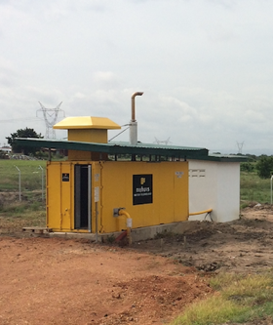
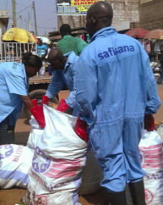
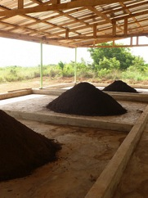
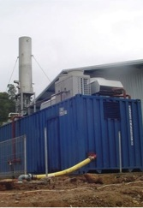
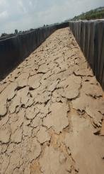



Main Presentation Title
A Business Approach for Improved Sanitation in Ghana – Organic Fertilisers and Energy as Drivers (Ashaiman –Ghana)
Raymond Okrofu
December 2016

Slide 2
Project Rationale
Provision of Sanitation on a firm business model
Provision of environmental sanitation for slum dwellers
The Ghana Government recognises that Environmental Sanitation is a powerful driver of human development in terms of improving health and increasing wealth
Current sanitation investment in Ghana is less than 0.1% GDP which is much lower than what is required
Weak capacities of MMDAS to tackle sanitation

Slide 3
Project Objective and Components
Objective
The main project objective is to catalyse improved hygiene, health and quality of life for urban slum communities in Greater Accra through demonstrated and replicable business models for improved sanitation services and waste management
Components
Sustainable waste collection and storage
Waste Treatment and Safe Re-use
Market entry of bio-fertiliser and electricity
Project Management and Knowledge Management

Slide 4
Project Outcomes
Increased access to improved sanitation
Increased private sector investment in affordable municipal-level anaerobic waste treatment approach
Enabling regulatory framework for accelerated national access to bio-fertilisers and energy
Improved knowledge on sustainable and replicable business models for combined FS / organic waste re-use

Slide 5
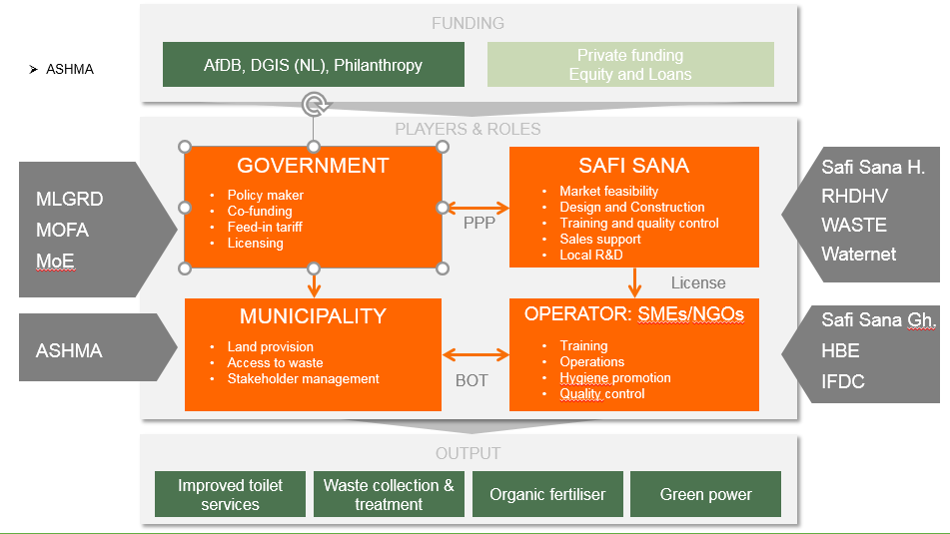
Project Stakeholders

Slide 6
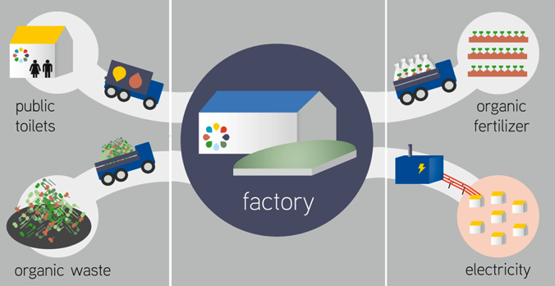
Project Input and Output

Slide 7
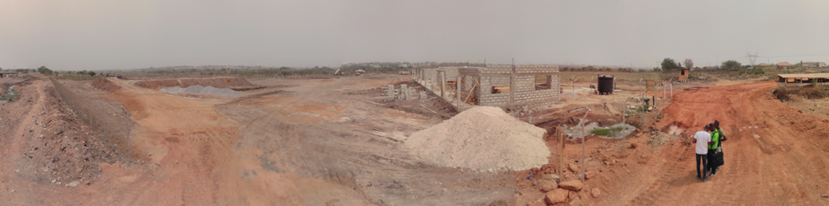
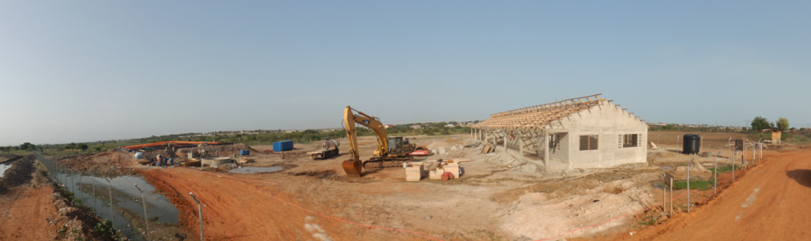
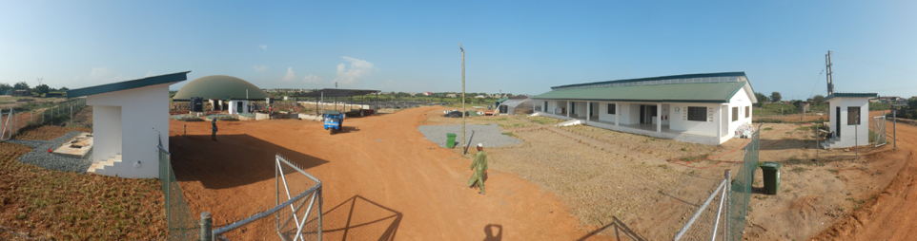
section within presentation title
February 2016
June 2016
subtitle
October 2016

Slide 8
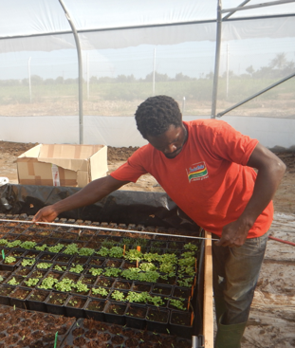
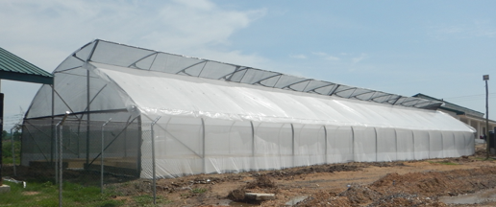
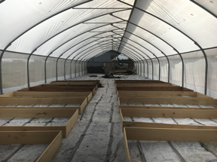
Greenhouse Installation for Vegetable Seedlings
Greenhouse 400m²
Kenny – first trials seedlings and irrigation system
Plant beds under construction

Slide 9
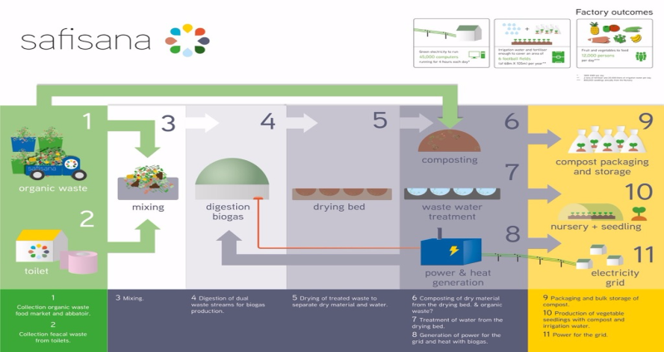
Achievements so Far

Slide 10
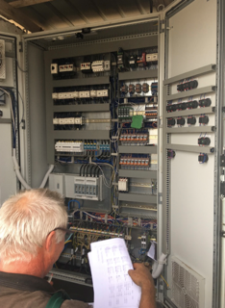
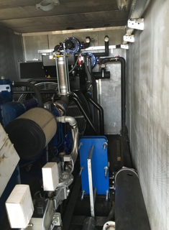
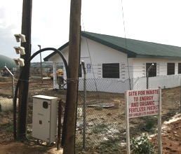
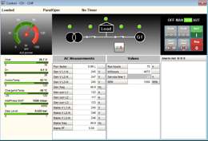
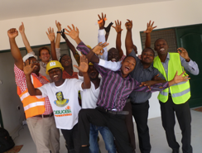
Power to Grid Installation
Connection to grid and main meter
CHP Installed and Operational 100KW
Switch board checks by supplier
Dash board CHP – measuring first
First kWh’s supplied to grid!

Slide 11
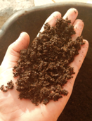
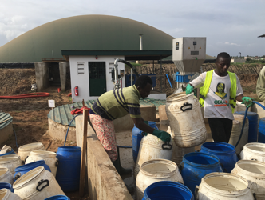
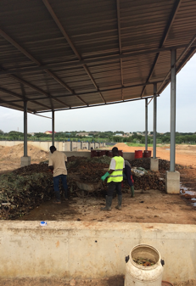
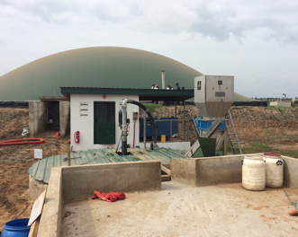
First compost batch
Operations
Intake food waste from markets
Generator container and grid switchboard shed
Solid waste intake and sorting
Mixing pit (faecal and organic waste) + macerator + digester

Slide 12
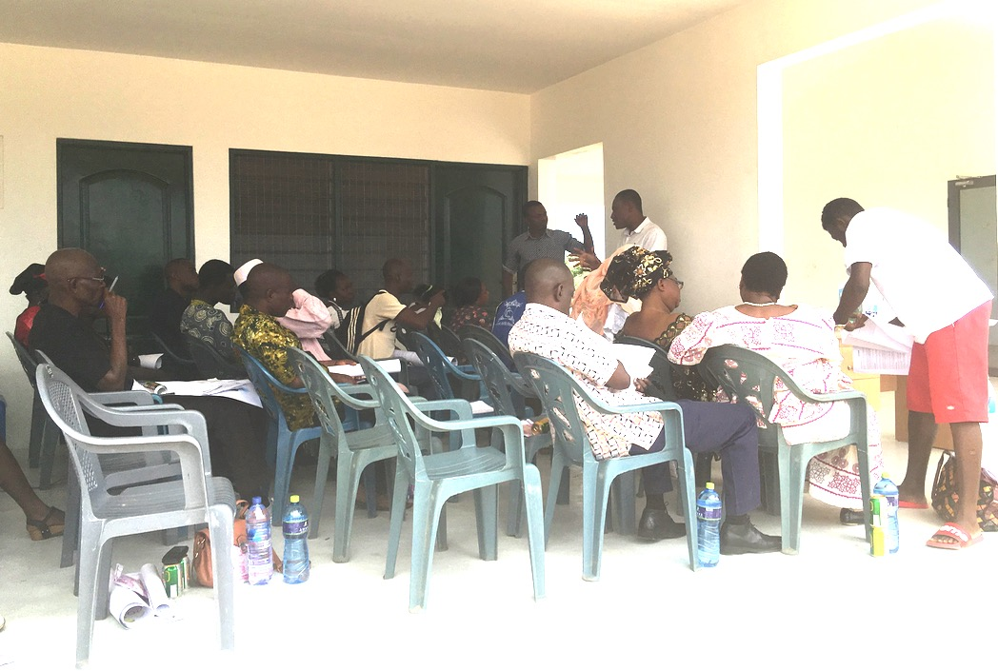
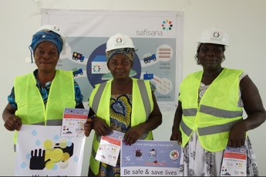
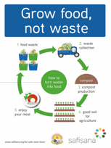
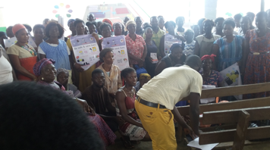
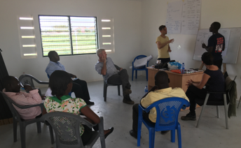

Training and Hygiene Promotion
Training of toilet operators
Training of Vendors
Hygiene promotion market queens
Training of operations by Waternet

Slide 13
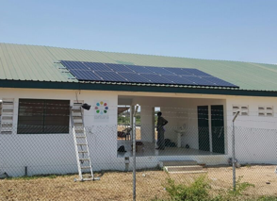
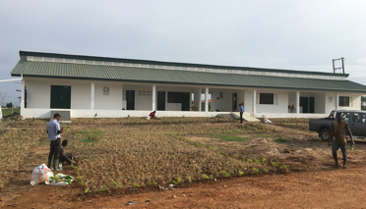
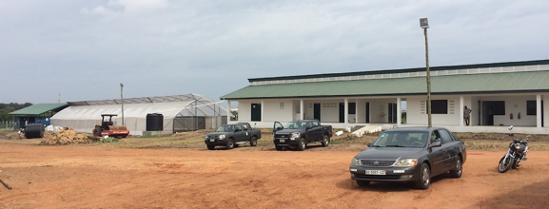
Office, Knowledge Centre and Laboratory
New solar panels at office 3.5 kWh (peak)
Landscaping front office
Compost storage, greenhouse and knowledge centre

Slide 14
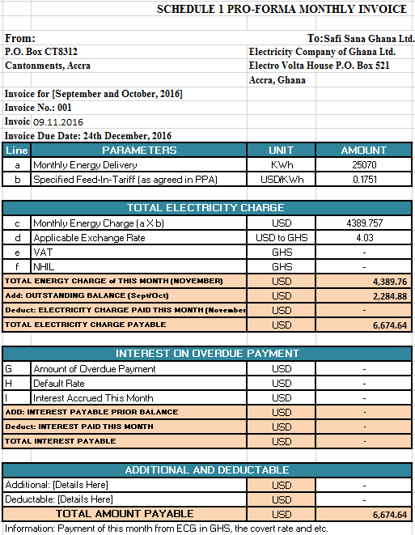
First Invoice from the sale of Electricity

Slide 15
Lessons Learnt so far
A huge in-balance between demand and supply
Obstacles to scaling up
Very limited funding options for municipalities
Need for tangible political commitment
Increased community engagement is key
Management of people’s expectations.

Slide 16
Roll-Out Strategy 2017-2023
Demo factory Ashaiman break-even 2017
License model with support services
Packaging (model and finance)
Policy advocacy new markets
Partnerships for roll out
End game in 2023:
  8 factories (Ghana and abroad)
  1,200,000 people impact

Slide 17
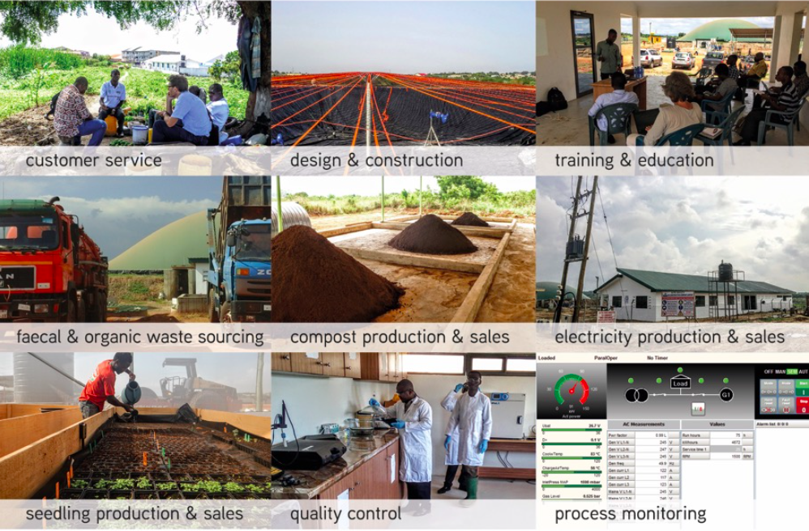
Business Model
Revenues:
  Sell turn-key projects
  License fee operations
Services to turn-key:
  Local partnerships
  Design and Build
  Training/capacity building
  Sales channels
  Remote monitoring

Slide 18
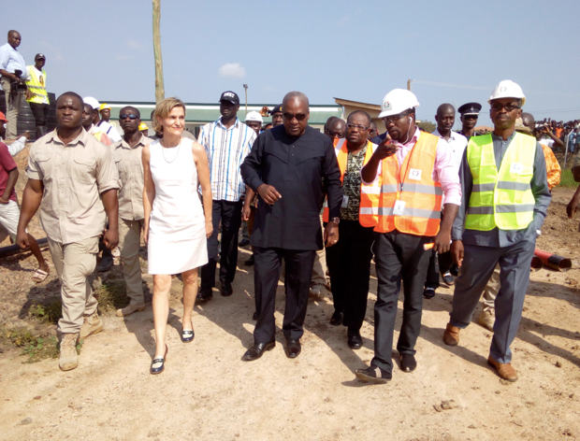
Visit by the President of Ghana

